Slide 1
SANDI KURNIA
QA 15

Slide 2









OVERVIEW
REQUIREMENT
Web Testing :
Membuat dan melakukan automation testing pada fitur yang telah ditentukan di Staging Cicle Web
Mobile Testing :
Membuat dan melakukan automation testing pada fitur yang telah ditentukan di Staging Cicle App
Programming Language :
Java
Framework :
Selenium
Cucumber
SCOPE OF TESTING
Checkin - main page
Checkin - add checkin
Checkin - edit checkin
Checkin - archive checkin
Checkin - add comment
Checkin - reply comment
Checkin - edit comment
Checkin - delete comment
Additional
Web Testing
Checkin - give cheers on comment
Checkin - give cheers on reply comment

Slide 3

IntelliJ IDEA CE
Ver 2022.2.3
WEB TESTING
Web Testing tools using IntelliJ

Slide 4

JAVA
Ver 1.8.0_341
Programming Language
Programming language using Java

Slide 5


Selenium Cucumber
Ver 3.141.59 Ver 7.5.0
Framework
x
Framework using Selenium and Cucumber

Slide 6

WEB TESTING

Slide 7

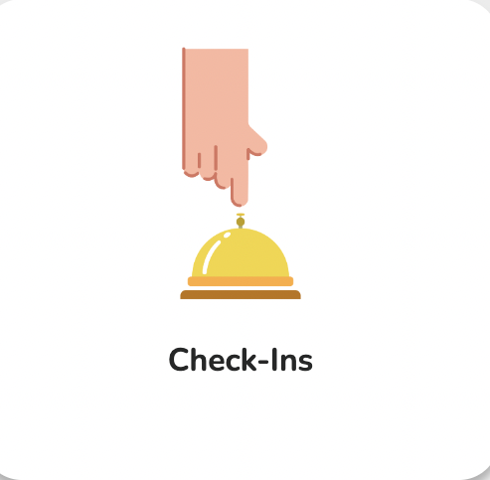
WHAT CICLE FEATURES WILL BE TESTED ?
Pengganti report meeting / report harian

Slide 8
1. Checkin - Main Page
Positive Test Case
User verify create checkin button
User verify dropdown menu button on the upper left side
User verify its questions can be open
Passed = 3
Failed = 0
-----------------------------------------
Percentage = 100%
Checkin - Add Checkin
Positive Test Case
User add checkin with input text in type your question field
User add checkin with select one of day
User add checkin with select all day
User add checkin with input valid time
User add checkin with select all subscriber
User cancel add checkin
Passed = 6
Failed = 0
-----------------------------------------
Percentage = 100%
Negative Test Case
User add checkin without input text in type your question field
User add checkin with input empty text using spaces button as empty character in type your question field
User add checkin with input invalid time without fill question field
Passed = 2
Failed = 1
-----------------------------------------
Percentage = 66,6%

Slide 9
Checkin - Edit Checkin
Positive Test Case
User edit checkin by input new text in type your question field
User edit checkin by adding all day
User edit checkin by adding new subscriber
User edit checkin by adding all subscriber
User edit checkin by set check in as private
User cancels to edit checkin
Passed = 6
Failed = 0
-----------------------------------------
Percentage = 100%
Negative Test Case
Passed = 0
Failed = 2
-----------------------------------------
Percentage = 0%
User edit checkin with input empty text in type your question field
User edit checkin with input empty text using spaces button as empty character in type your question field
Checkin - Archive Checkin
Positive Test Case
Passed = 1
Failed = 0
-----------------------------------------
Percentage = 100%
User archive checkin
Negative Test Case
Passed = 1
Failed = 0
-----------------------------------------
Percentage = 100%
User archive checkin with already archived

Slide 10
Checkin - Add Comment
Positive Test Case
User add new comment by input text in tell your story field
Verify text in bold format using bold buttons
Verify text in italic format using italic buttons
Verify text in strikethrough format using strikethrought buttons
Verify text with background color using background color buttons
Verify text font size format using font size buttons
Verify the ordered list format function by input text in tell your story field
Verify the drop-down unordered list function by input text in the tell your story field
Verify insert files by upload supported file in the tell your story field
Verify insert files by input files using valid url
Verify insert image by upload supported image
Verify insert image by input image using valid url
Verify insert video by upload supported video
Verify insert video by valid video url
User cancels to add new comment
Passed = 15
Failed = 0
-----------------------------------------
Percentage = 100%
Negative Test Case
User add new comment with input empty text in tell your story field
User add new comment with input empty text using space button as empty character in tell your story field
Verify insert files by upload unsupported file in the tell your story field
Verify insert files by input invalid url in the tell your story field
Verify insert image by upload unsupported image
Verify insert image by input invalid url
Verify insert video by upload unsupported video
Verify insert video by input invalid video url
Passed = 7
Failed = 1
-----------------------------------------
Percentage = 87,5%

Slide 11
Checkin - Reply Comment
Positive Test Case
User reply comment by input text in tell your story field
Verify text in bold format using bold buttons
Verify text in italic format using italic buttons
Verify text in strikethrough format using strikethrought buttons
Verify text with background color using background color buttons
Verify text font size format using font size buttons
Verify the ordered list format function by input text in tell your story field
Verify the drop-down unordered list function by input text in the tell your story field
Verify insert files by upload supported file in the tell your story field
Verify insert files by valid url
Verify insert image by upload supported image
Verify insert image by input image using valid url
Verify insert video by upload supported video
Verify insert video by valid video url
User cancels to add new comment
Passed = 15
Failed = 0
-----------------------------------------
Percentage = 100%
Negative Test Case
User reply comment with input empty text in tell your story field
User reply comment with input empty text using space button as empty character in tell your story field
Verify insert files function by upload unsupported file in the tell your story field
Verify insert files by input invalid url
Verify insert image by upload unsupported image
Verify insert image by input invalid url
Verify insert video by upload unsupported video
Verify insert video by input invalid video url
Passed = 7
Failed = 1
-----------------------------------------
Percentage = 87,5%

Slide 12
Checkin - Edit Comment
Positive Test Case
User edit comment by input text in tell your story field
Verify text in bold format using bold buttons
Verify text in italic format using italic buttons
Verify text in strikethrough format using strikethrought buttons
Verify text with background color using background color buttons
Verify text font size format using font size buttons
Verify the ordered list format function by input text in tell your story field
Verify the drop-down unordered list function by input text in the tell your story field
Verify insert files by upload supported file in the tell your story field
Verify insert files by valid url
Verify insert image by upload supported image
Verify insert image by input image using valid url
Verify insert video by upload supported video
Verify insert video by valid video url
User cancels to edit comment
Passed = 15
Failed = 0
-----------------------------------------
Percentage = 100%
Negative Test Case
User edit comment with input empty text in tell your story field
User edit comment with input empty text using space button as empty character in tell your story field
Verify insert files function by upload unsupported file in the tell your story field
Verify insert files by input invalid url
Verify insert image by upload unsupported image
Verify insert image by input invalid url
Verify insert video by upload unsupported video
Verify insert video by input invalid video url
Passed = 7
Failed = 1
-----------------------------------------
Percentage = 87,5%

Slide 13
Checkin - Delete Comment
Positive Test Case
Passed = 2
Failed = 0
-----------------------------------------
Percentage = 100%
User delete comment
User cancel delete comment
Additional Web Testing
Checkin - Give Cheers on Comment
Positive Test Case
User give cheers on comment by input text in tell your story field
User give cheers on comment by input emoticon
User cancel give cheers on comment
Passed = 3
Failed = 0
-----------------------------------------
Percentage = 100%
Negative Test Case
User give cheers on comment by input empty text in cheers field
User give cheers on comment by input empty text using spaces button as character in cheers field
Passed = 1
Failed = 1
-----------------------------------------
Percentage = 50%

Slide 14
Checkin - Give Cheers on Reply Comment
Positive Test Case
Passed = 3
Failed = 0
-----------------------------------------
Percentage = 100%
User give cheers on reply comment by input text in tell your story field
User give cheers on reply comment by input emoticon
User cancel give cheers on reply comment
Negative Test Case
User give cheers on reply comment by input empty text in cheers field
User give cheers on reply comment by input empty text using spaces button as character in cheers field
Passed = 1
Failed = 1
-----------------------------------------
Percentage = 50%

Slide 15
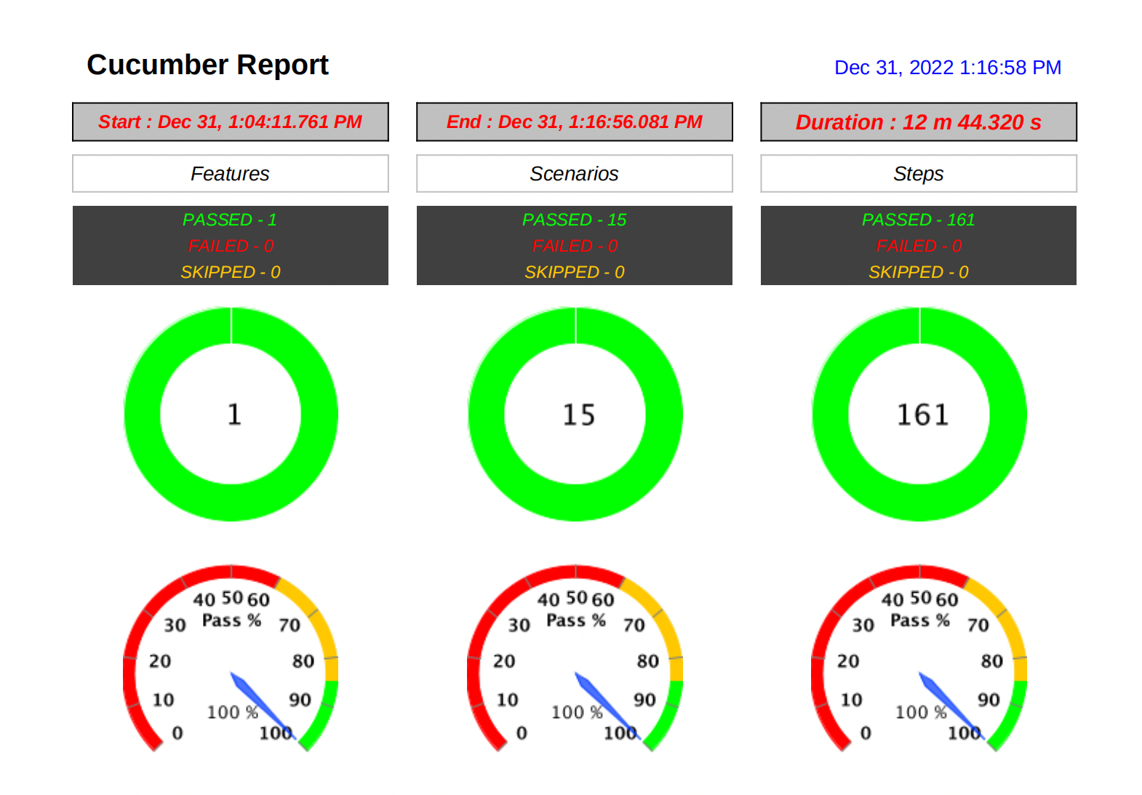
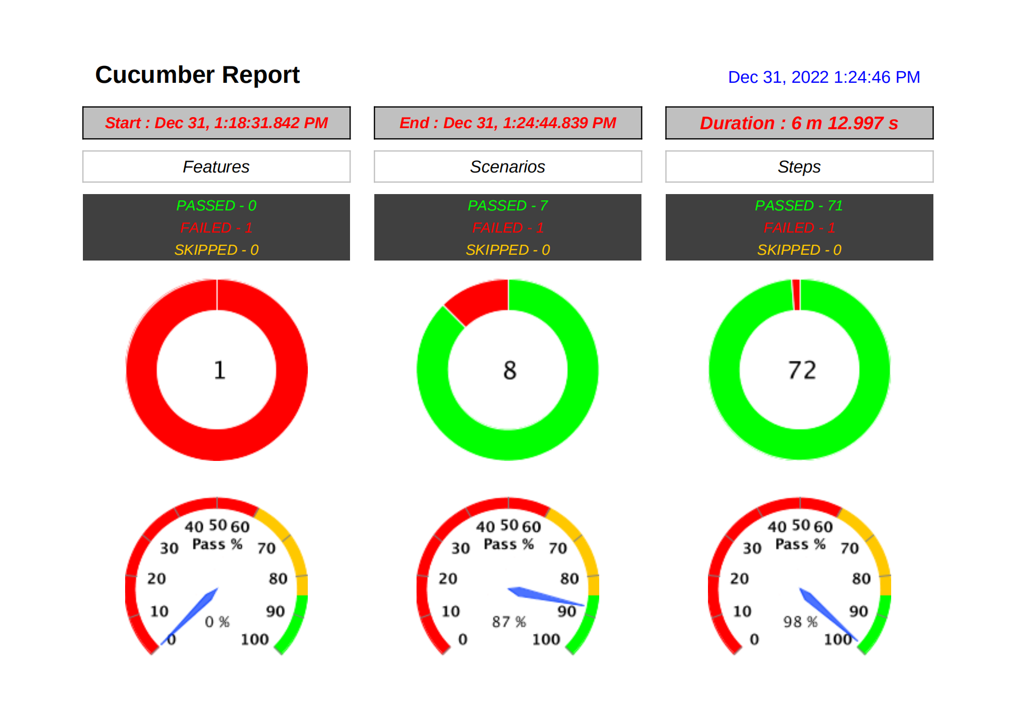
Cucumber Report Results for
All of Add comment feature
Positive Add Comment
Negative Add Comment

Slide 16
BUG / DEFECT
Checkin - Add Checkin
User add checkin with input empty text using spaces button as empty character in type your question field
Checkin - Edit Checkin
User edit checkin with input empty text in type your question field
User edit checkin with input empty text using spaces button as empty character in type your question field
Checkin - Add Comment
User add new comment with input empty text using space button as empty character in tell your story field
Checkin - Reply Comment
User reply comment with input empty text using space button as empty character in tell your story field
Checkin - Edit Comment
User edit comment with input empty text using space button as empty character in tell your story field
Checkin - Give Cheers on Comment
User give cheers on comment by input empty text using spaces button as character in cheers field
Checkin - Give Cheers on Reply Comment
User give cheers on reply comment by input empty text using spaces button as character in cheers field

Slide 17
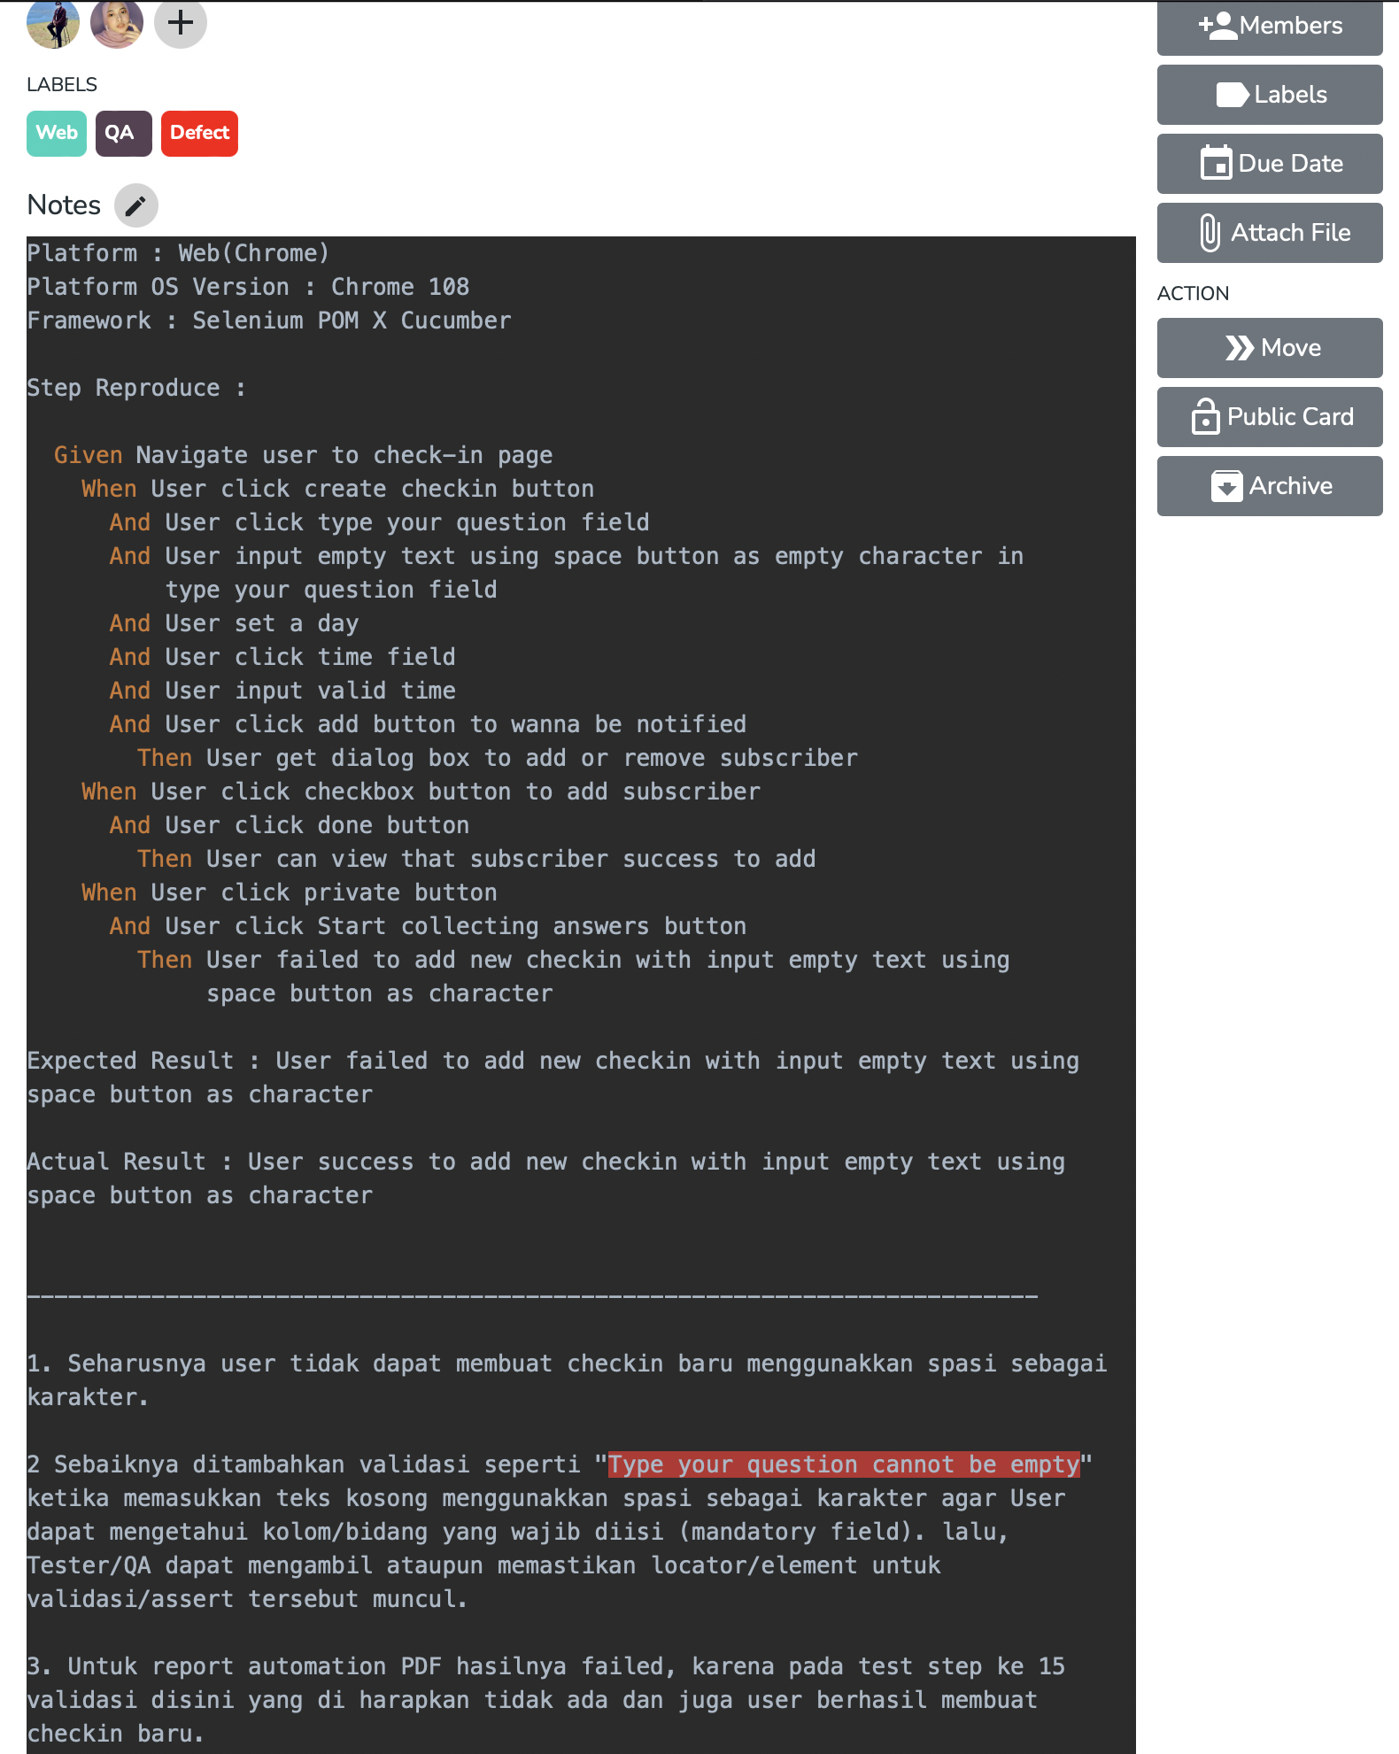
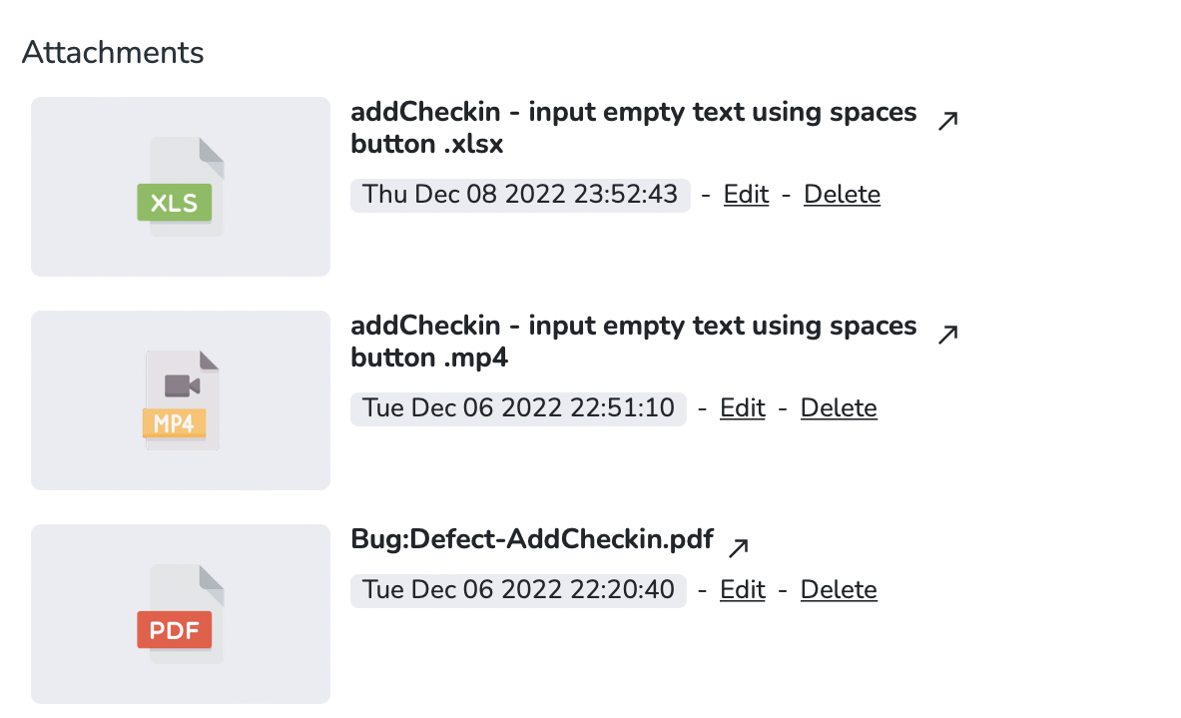
Report bug / defect on card
Checkin - Add Checkin
User add checkin with input empty text using spaces button as empty character in type your question field

Slide 18

MOBILE TESTING

Slide 19

APPIUM INSPECTOR
Ver 2022.9.1
APPIUM INSPECTOR
Is used to identify the UI elements of the application being tested

Slide 20
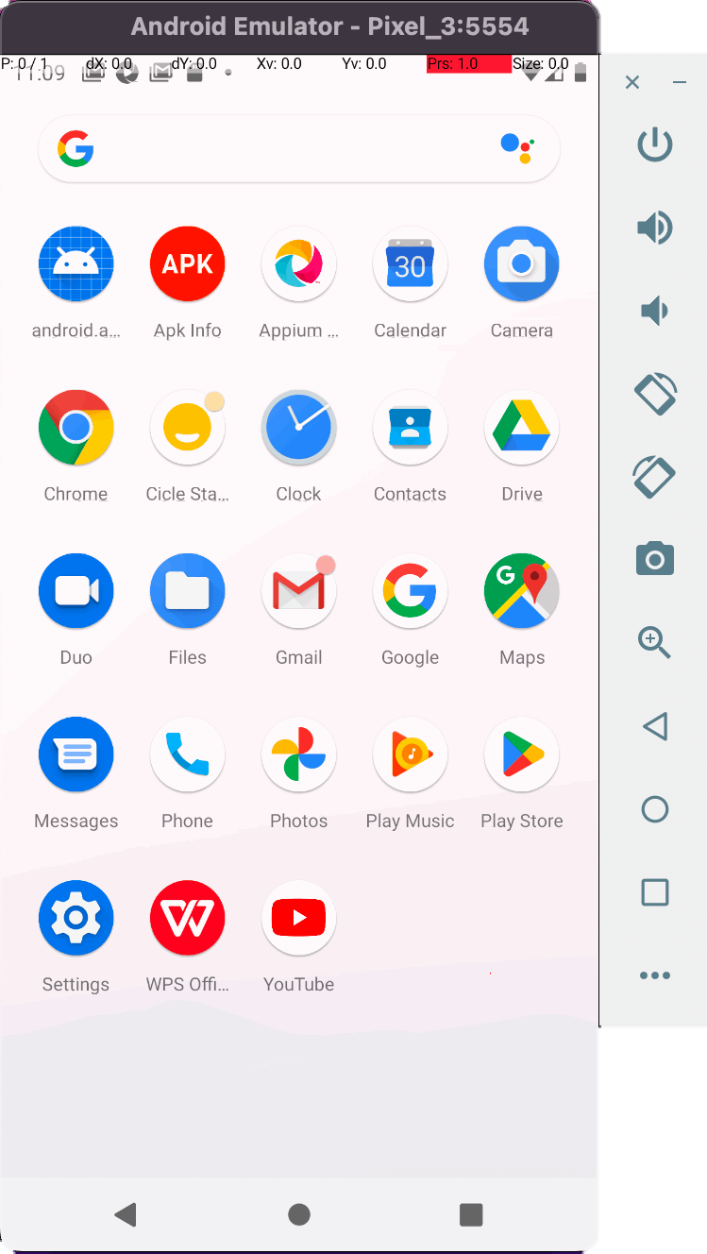

Android Studio
Android Studio
Ver 2021.3
Device OS : Android
Device Id : emulator-5554
Device Model : Android SDK built for arm64
Device Manufacturer : Google Pixel 3
Device OS Version : 10

Slide 21
1. Checkin - Main Page
Positive Test Case
Verify create checkin button on main page
Verify scroll down on main page
Verify scroll up on main page
Verify swipe left on main page
Verify Back Button on main page
Verify dropdown menu in upper right side on main page
Passed = 6
Failed = 0
-----------------------------------------
Percentage = 100%
Passed = 1
Failed = 0
-----------------------------------------
Percentage = 100%
Negative Test Case
Verify swipe right on main page
Checkin - Add Checkin
Positive Test Case
User add new checkin
User add new checkin with select all day
User add new checkin for private only
User add new checkin with unselect all member companies to be notified
User Add New Check-In with Input Valid Time
Passed = 5
Failed = 0
-----------------------------------------
Percentage = 100%
Negative Test Case
User add new checkin without input text in type your question field
User Add Checkin with Input Empty Text using Spaces button As Empty Character in Type Your Question Field
User Add New Checkin without Select The Days
User Add New Checkin without set the time
User Add New Checkin with input invalid time
User add new check in by adding already notified members
Passed = 4
Failed = 2
-----------------------------------------
Percentage = 66,6%

Slide 22
Checkin - Edit Checkin
Positive Test Case
User edits checkin by changing the question type
User edits checkin by changing the days
User edits checkin by changing time
User edits checkin by unselect all member companies to be notified
User edits checkin by changing to private only
User cancel to edits checkin
Passed = 6
Failed = 0
-----------------------------------------
Percentage = 100%
Negative Test Case
User edits checkin by changing the question type with input empty text
User edits checkin by changing the question type with input empty text using space button as character
User edits checkin by adding already notified members
Passed = 1
Failed = 2
-----------------------------------------
Percentage = 33.3%
Checkin - Archive Checkin
Positive Test Case
Passed = 2
Failed = 0
-----------------------------------------
Percentage = 100%
User archive checkin by clicking yes button
User cancel archive checkin by clicking cancel button

Slide 23

Checkin - Add Comment
Positive Test Case
User add new comment with input text in tell your story field
Verify mention user by selecting the user manually
Verify text in bold format using bold buttons
Verify text in italic format using italic buttons
Verify text in strikethrough format using strikethrought buttons
Verify the ordered list format function by input text in tell your story field
Verify the unordered list format function by input text in tell your story field
Verify insert files with add image function by uploading a supported image
User add comments with insert files with add image function by valid url
Passed = 9
Failed = 0
-----------------------------------------
Percentage = 100%
Negative Test Case
User add new comment without input text in tell your story field
User add new comment with input empty text using space button as character in tell your story field
User add comment with add image by invalid url
User add comment with add file by invalid url
User add comment with add video by invalid url
Passed = 5
Failed = 0
-----------------------------------------
Percentage = 100%

Slide 24
Checkin - Reply Comment
Positive Test Case
User reply comments with input text in tell your story field
User reply comments with mention user by selecting the user manually
User reply comments with input text in bold format using bold buttons
User reply comments with input text in italic format using italic buttons
User reply comments with input text in strikethrough format using strikethrought buttons
User reply comments with ordered list format function by input text in tell your story field
User reply comments with unordered list format function by input text in tell your story field
User reply comments with insert files with add image function by uploading a image
User reply comments with insert files with add image function by valid url
Passed = 9
Failed = 0
-----------------------------------------
Percentage = 100%
Negative Test Case
User reply comments without input text in tell your story field
User reply comments with empty text using space button as character in tell your story field
User add image by invalid url
User add file by invalid url
User add video by invalid url
Passed = 5
Failed = 0
-----------------------------------------
Percentage = 100%

Slide 25
Checkin - Edit Comment
Positive Test Case
User edit comment with input text in tell your story field
User edit comment with mention user by selecting the user manually
Verify text in bold format using bold buttons
Verify text in italic format using italic buttons
Verify text in strikethrough format using strikethrought buttons
Verify the ordered list format function by input text in tell your story field
Verify the unordered list format function by input text in tell your story field
Verify insert files with add image function by uploading a supported image
User edit comments with insert files with add image function by valid url
Passed = 9
Failed = 0
-----------------------------------------
Percentage = 100%
Negative Test Case
User edit comment with delete text in type your story field without input text
User edit comment with input empty text using space button as character in tell your story field
User edit comment with add image by invalid url
User edit comment with add file by invalid url
User edit comment with add video by invalid url
Passed = 5
Failed = 0
-----------------------------------------
Percentage = 100%
Checkin - Delete Comment
Positive Test Case
Passed = 2
Failed = 0
-----------------------------------------
Percentage = 100%
User delete comment by clicking yes button
User cancel delete comment by clicking cancel button

Slide 26
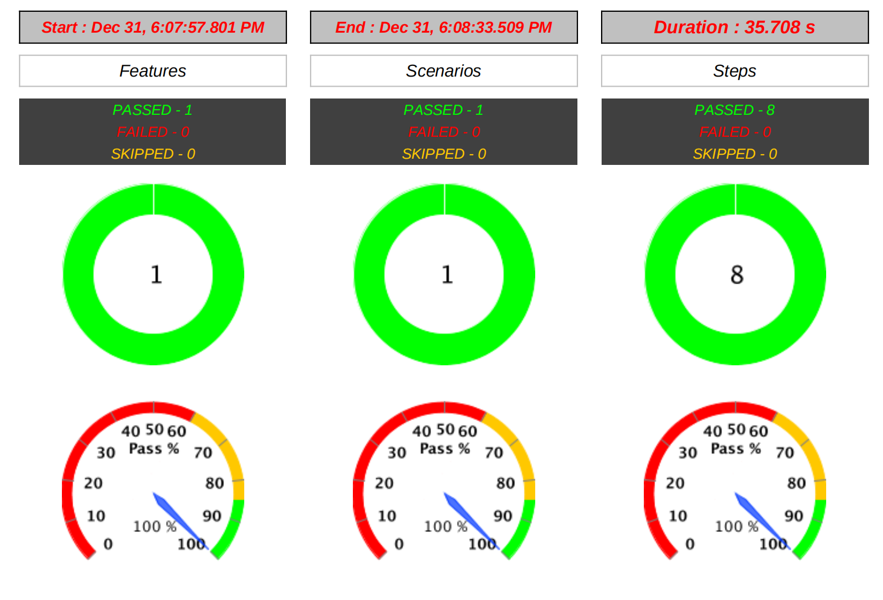
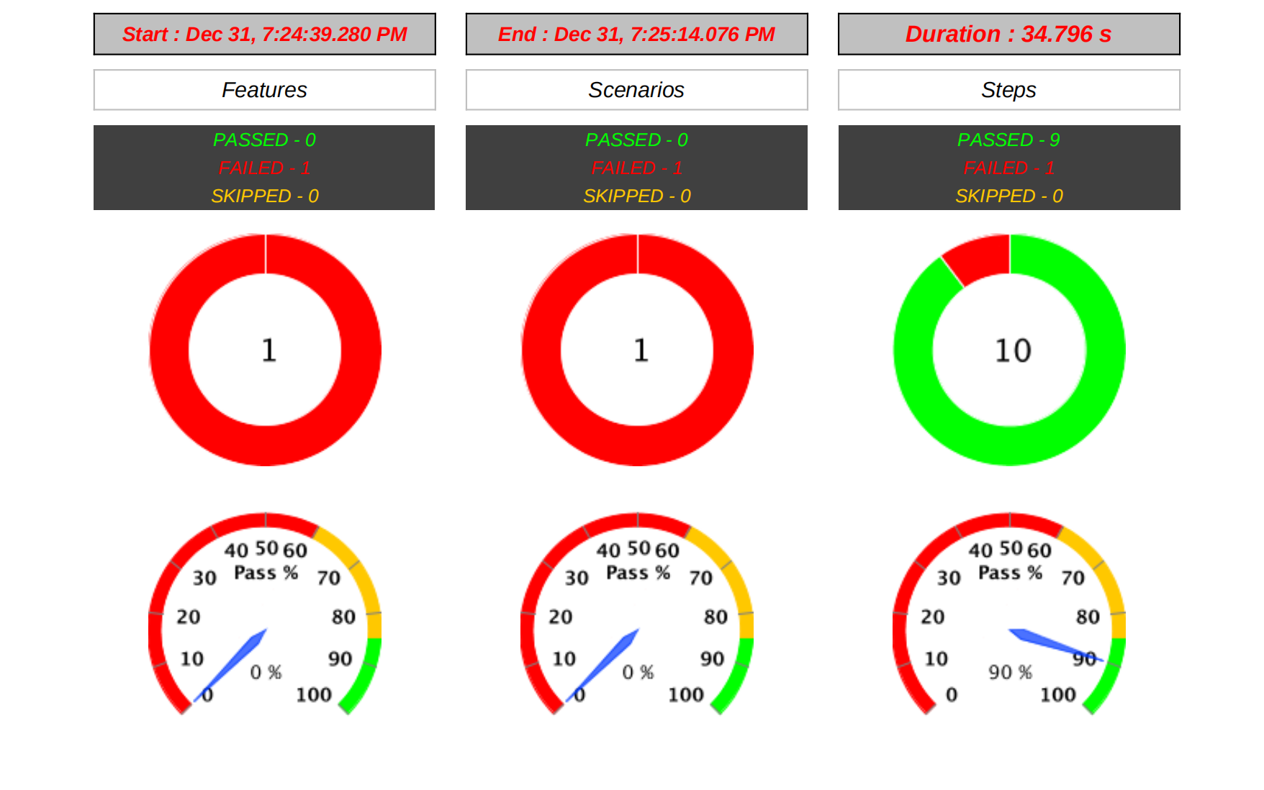
Cucumber Report Results for
Add checkin feature
Positive -User Add New Checkin
Negative - User add new check in
by adding already notified members

Slide 27
BUG / DEFECT
Checkin - Add Checkin
User Add Checkin with Input Empty Text using Spaces button As Empty Character in Type Your Question Field
User add new check in by adding already notified members
Checkin - Edit Checkin
User edits checkin by changing the question type with input empty text using space button as character
User edits checkin by adding already notified members

Slide 28
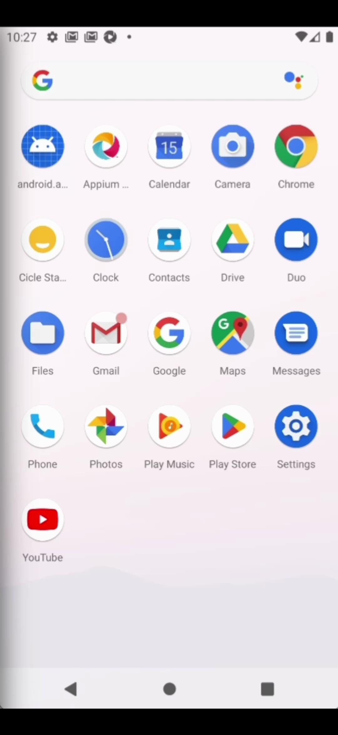
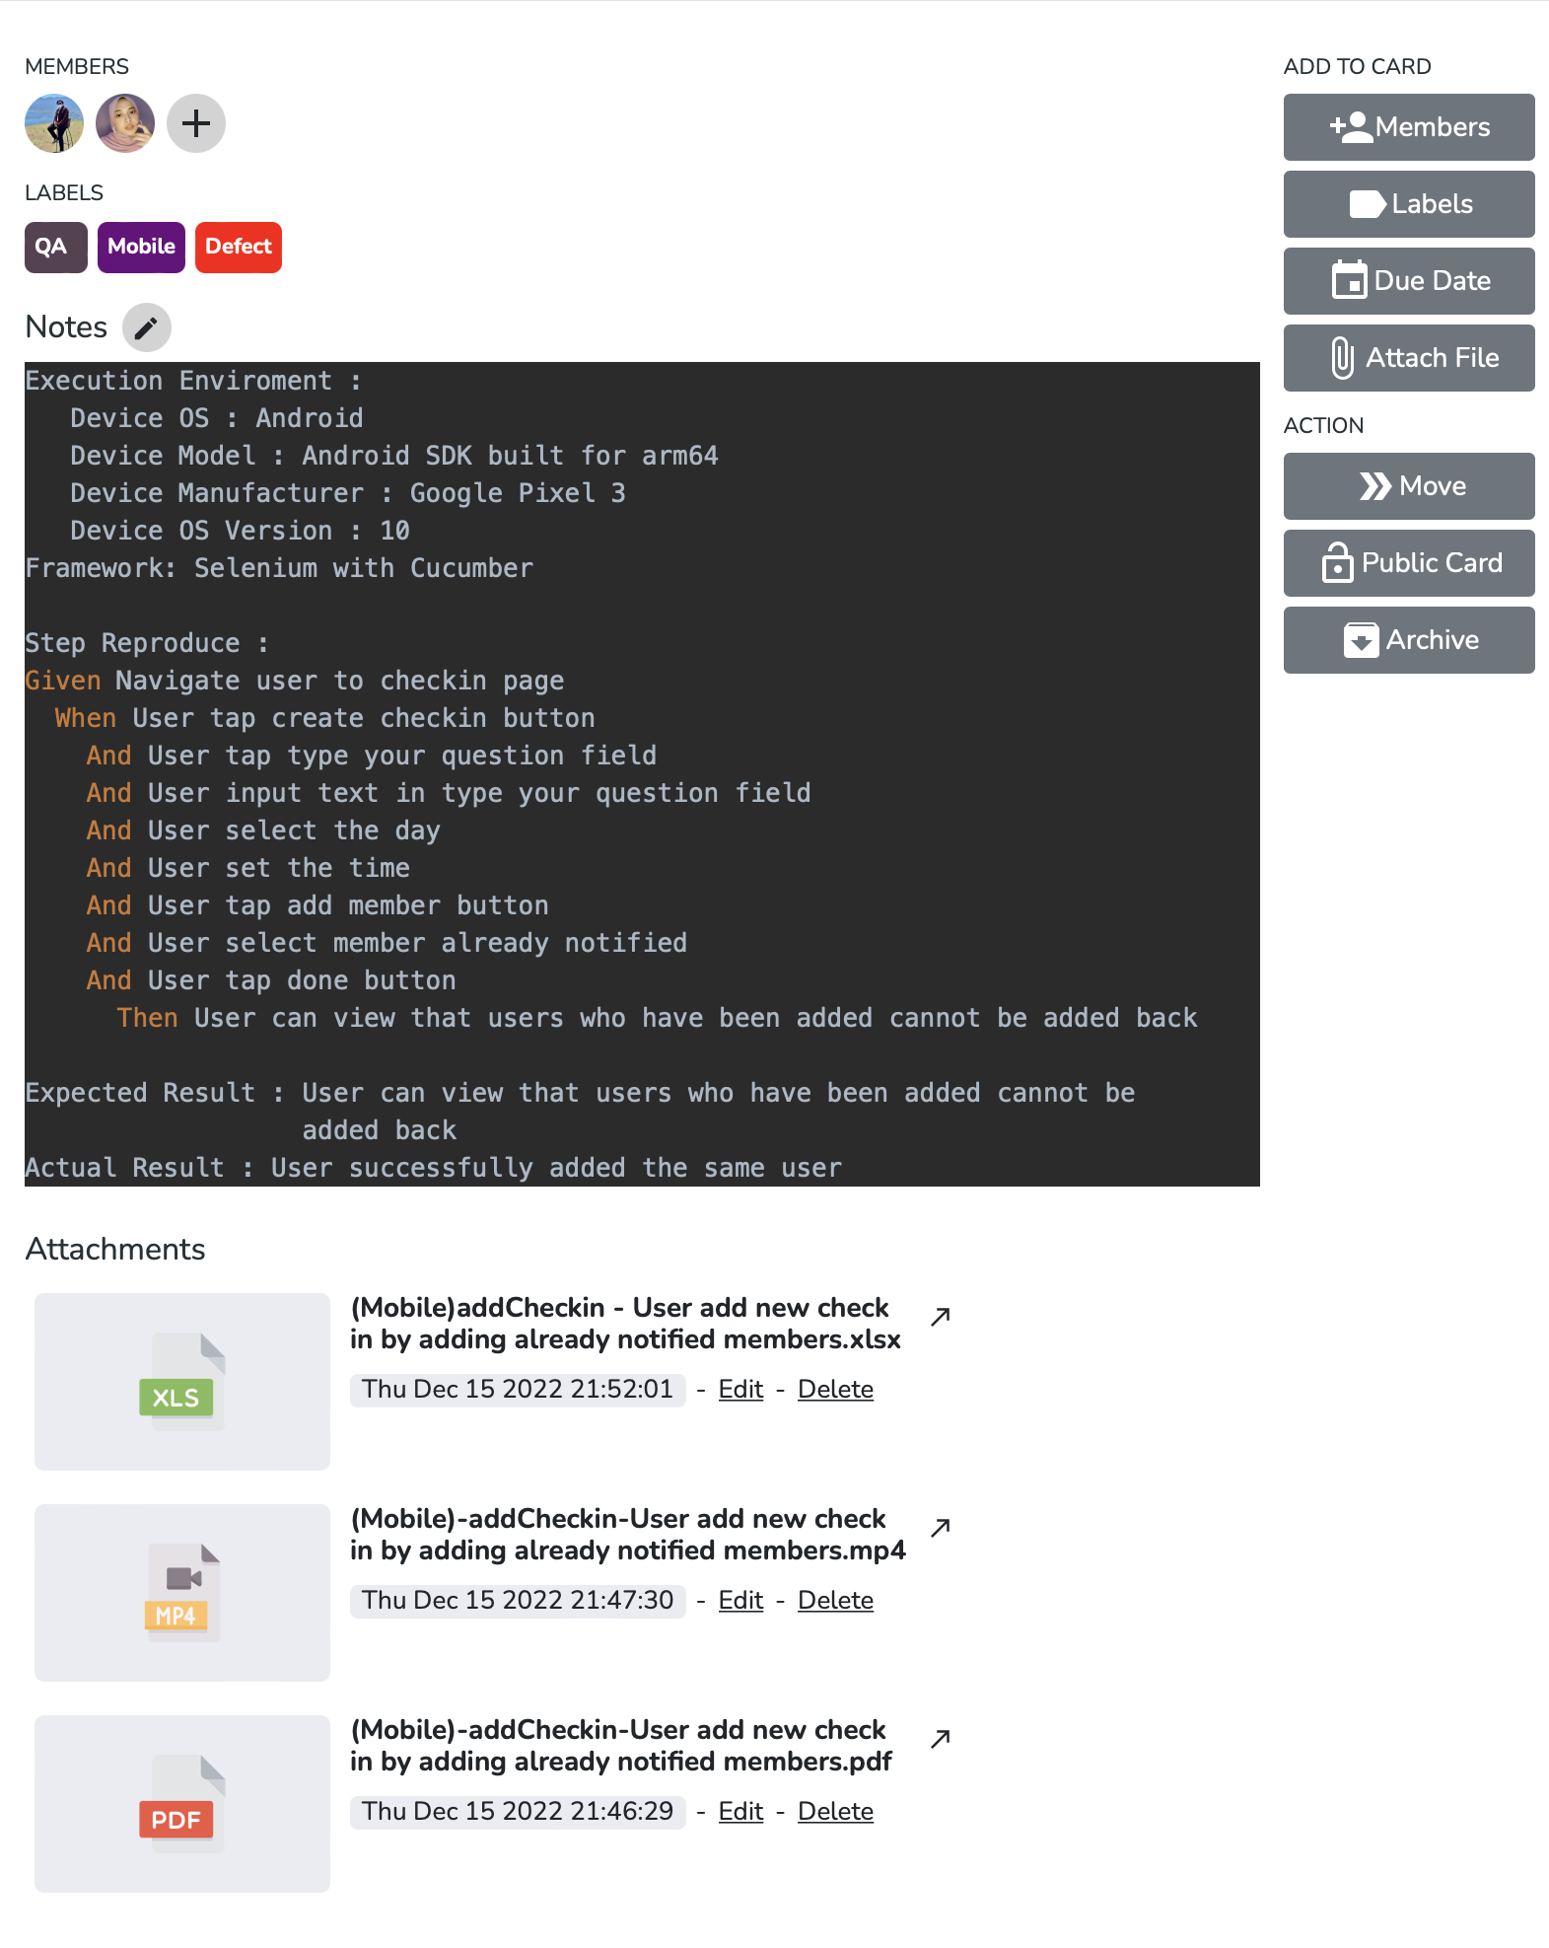
Report bug / defect on card
Checkin - Add Checkin
User add new check in by adding already notified members

Slide 29
Objective: Ensure the quality of feature with minimum bugs
Key Result: Testing min 3 feature / week
Week | Progress | Sad | Concerned | Happy | Feature | Web/Mobile | Test Case_Positive | Test Case_Negative | Result
 |  |  |  |  |  |  |  |  | Passed | Failed
W1 | 5 | 2 | 3 | 4 | 5 | Web | 30 | 11 | 37 | 4
W2 | 3 | 2 | 3 | 4 | 3 | Mobile | 16 | 10 | 22 | 4
W3 | 3 | 2 | 3 | 4 | 3 | Mobile | 20 | 12 | 32 | 0
W4 | 8 | 2 | 3 | 4 | 8 | Mobile | 13 | 3 | 16 | 0
 | 10 | 2 | 3 | 4 | 10 | Web | 39 | 23 | 58 | 4
Page/Feature name | Mobile |  | Web
 | Positive | Negative | Positive | Negative
checkin (main page) | 6 | 1 | 3 | 0
checkin - add checkin | 5 | 6 | 6 | 3
checkin - edit checkin | 6 | 3 | 6 | 2
checkin - archive checkin | 3 | 0 | 1 | 1
checkin - add comment | 9 | 5 | 15 | 8
checkin - reply comment | 9 | 5 | 15 | 8
checkin - edit comment | 9 | 5 | 15 | 8
checkin - delete comment | 2 | 0 | 2 | 0
private chat (main page)
doc & file (main page)
search jump to
kanban
my task
workload
Additional
checkin - give cheers on comment |  |  | 3 | 2
checkin - give cheers on reply comment |  |  | 3 | 2
Total | 49 | 25 | 69 | 34
Mobile | 74
Web | 103
Key Result: Identify bug/defect max 3 scenario/ week
Week | Progress | Sad | Concerned | Happy | Feature | Web/Mobile | Test Case_Positive | Test Case_Negative | Result
 |  |  |  |  |  |  |  |  | Passed | Failed
W1 | 4 | 5 | 3 | 2 | 3 | Web | 0 | 4 | 0 | 4
W2 | 4 | 5 | 3 | 2 | 2 | Mobile | 0 | 4 | 0 | 4
W3 | 0 | 5 | 3 | 2 | 0 | Mobile | 0 | 0 | 0 | 0
W4 | 0 | 5 | 3 | 2 | 0 | Mobile | 0 | 0 | 0 | 0
 | 4 | 5 | 3 | 2 | 2 | Web | 0 | 4 | 0 | 4
Key Result: Retest bugs or defects max 10 scenarios at the end of the month
Month | Progress | Sad | Concerned | Happy | Feature | Web/Mobile | Test Case_Positive | Test Case_Negative | Result
 |  |  |  |  |  |  |  |  | Passed | Failed
M1 | 8 | 10 | 7 | 3 | 10 | Web | 0 | 8 | 0 | 8
 | 4 | 10 | 7 | 3 | 2 | Mobile | 0 | 4 | 0 | 4

Slide 30
CONCLUSION AND SUGGESTION

Slide 31
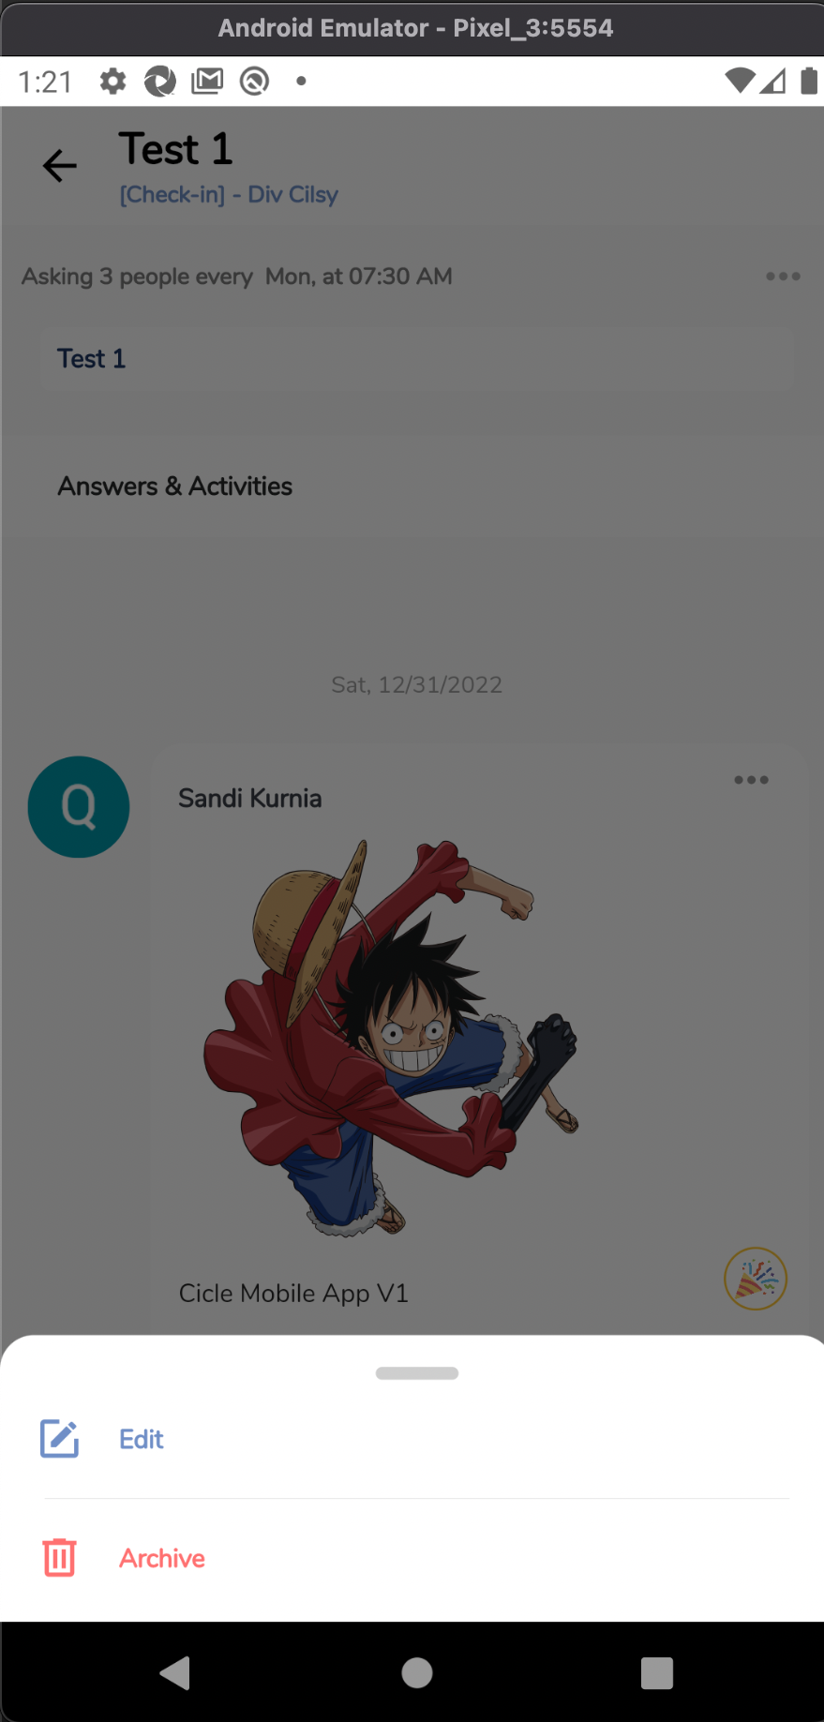
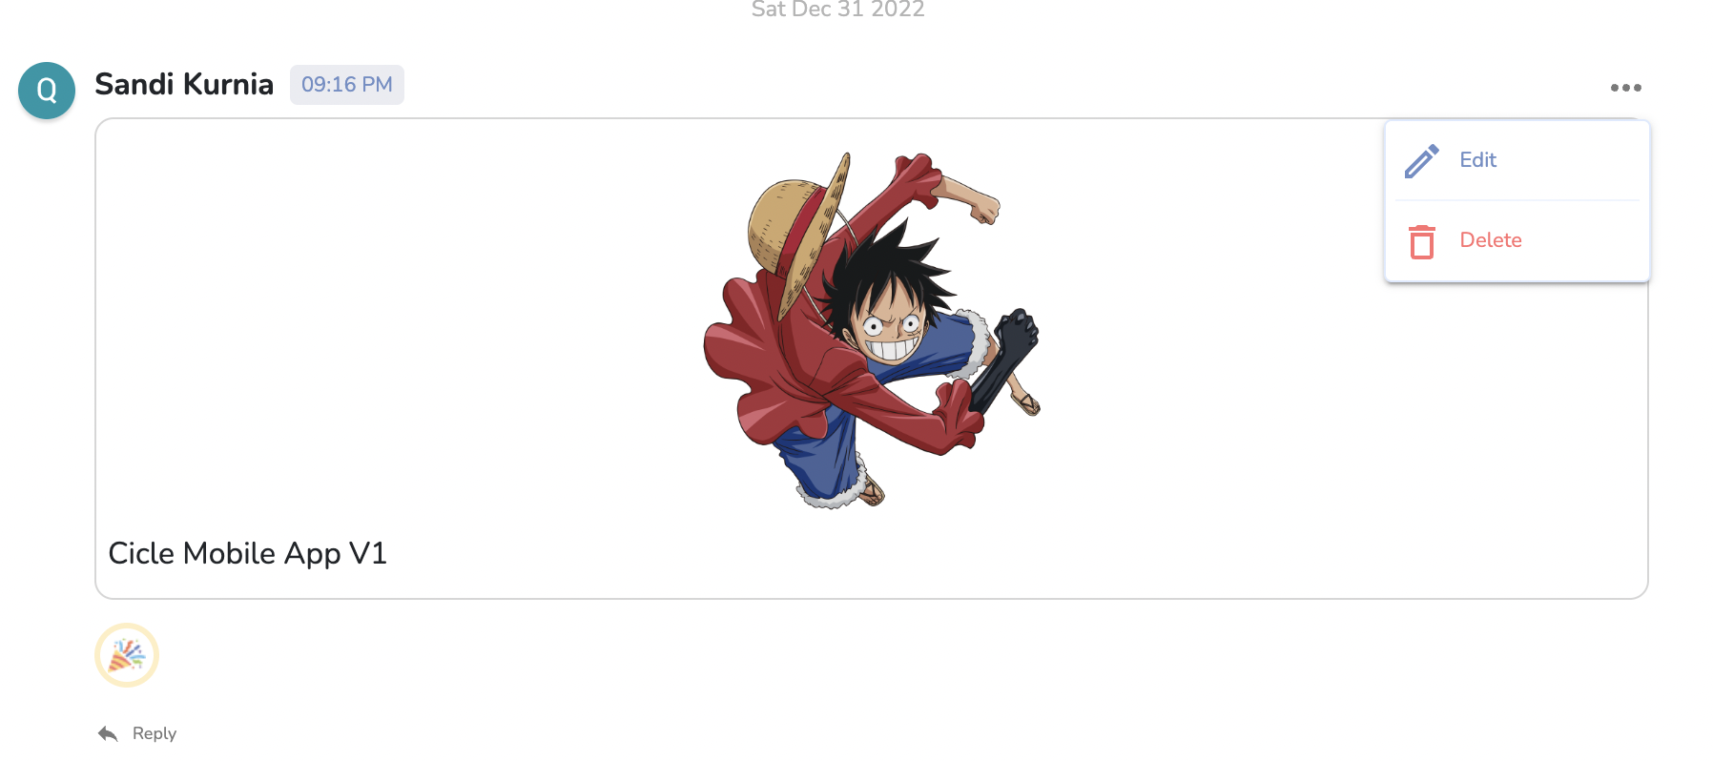
Feedback
Mobile
Web
Archive = Delete
No restore archive feature

Slide 32
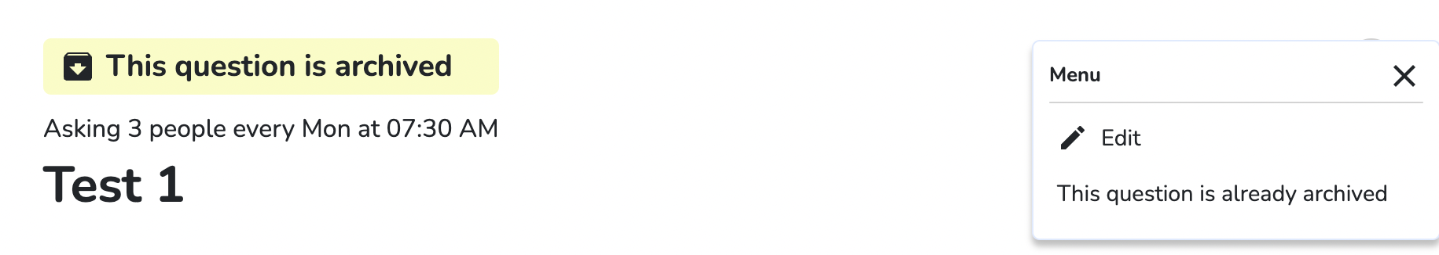
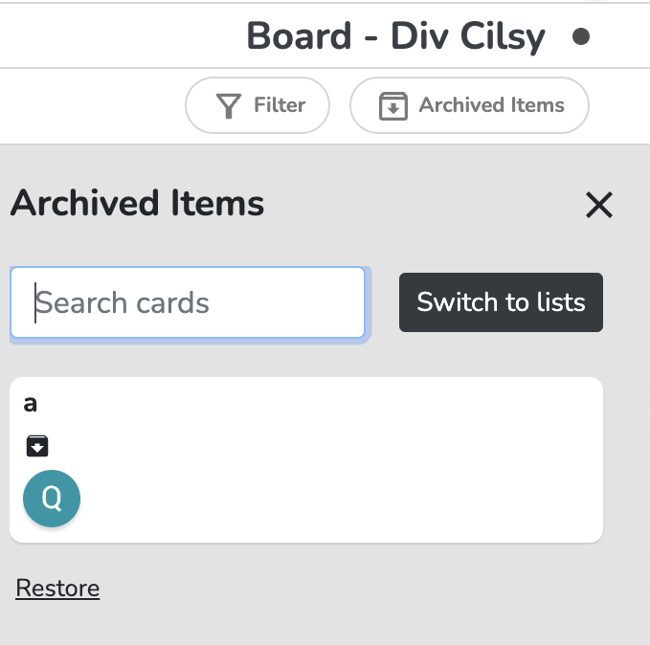
Web
No restore archived feature

Slide 33
Thank You.

